Slide 1

Creating plugins to extend QGIS for biological data
The experience of one LERC!
Alex Waechter
Records Centre Manager
Notes:
Hi everyone. My name is Alex and I’ve been with the Herts ERC for about 8 years now. We use QGIS as our primary everyday GIS, and we also use it as a way of interfacing with our Recorder 6 database to make it easier to serve up our species and site attribute data in friendly formats to help answer our most frequent questions. We do this through a set of custom QGIS plugins.
Most of our QGIS plugins actually pre-date me, so I can’t take any of the credit for the ambition or knowledge that created the various plugins that we use in our everyday work, and I’ve definitely had an advantage in being able to modify and add functionality as opposed to start from scratch. But there’s a lot that can be learned by doing, and the goal of this session is cover off the elements of building a plugin that are harder to self-teach, that benefit from having someone show them and talk you through them, so that you feel more equipped to go back into your own LERC and experiment.
You do not need any prior knowledge of plugins or programming to get something out of this, hopefully, if I’ve done this right! We’re going to start from the beginning with what a plugin is and how they add to the core QGIS application but then we will move into some actual applied trying stuff out that if you want to follow along in your own QGIS, you can.
Switch to QGIS

Slide 2
By the end of these two hours, you will:
See the potential
See the creation of a plugin from start to finish
- Know where to find support
Have a template for a nearly-functioning useful plugin that you can finish at home
Plan
Build Framework
Design Dialogues
Compile
Connect a Database
Write Python
Test and Troubleshoot
Publish
Notes:
My goal for today is that I’d like to you to come out of these two hours feeling like this is something that you will go back to your LERC and try. Hopefully you will come out of the session fired up with ideas. Hopefully you will feel equipped to carry out the try-it-at-home exercise.

Slide 3

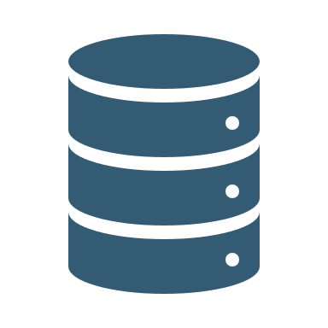


Why Bother?
Plan
Build Framework
Design Dialogues
Compile
Connect a Database
Write Python
Test and Troubleshoot
Publish
Integrate other data holdings with your spatial data
Automation
Customisation and Control

Slide 4
Why Bother?
Plan
Build Framework
Design Dialogues
Compile
Connect a Database
Write Python
Test and Troubleshoot
Publish
What is the question I’m trying to answer?
What is the output that will answer that question, and what does it look like?
What data will be required to produce that output?
Where is the data, and how will it be accessed?
Do I need to retrieve attributes of that data?
Are there elements that need to be calculated?

Slide 5
Why Bother?
Plan
Build Framework
Design Dialogues
Compile
Connect a Database
Write Python
Test and Troubleshoot
Publish
What user input does it need?
How will that input be captured? Map click, dialogue box, both?
What are the steps that I would take if I were doing the job manually?
Are there any existing plugins that do something similar to what I need, or have steps or elements in common with what I need?

Slide 6
Why Bother?
Plan
Build Framework
Design Dialogues
Compile
Connect a Database
Write Python
Test and Troubleshoot
Publish
Planning Placefinder
Establish database connection
Capture the placename the user wants to search for – set to variable
-> dialogue box
-> what will the dialogue box look like? Also needs to present matches back to the user and capture choice
Maximise chance of matching with database places
-> string cleaning. Get rid of dodgy characters, deal with lower case/upper case
Insert search term into SQL query string
-> need table and field names to go into query. Which fields do I need to return?
Create empty variables to receive the query results.
-> how do I want to structure these? Lists holding the returned values for each individual field
Run query, putting returned values into their respective list variables
Update dialogue box with the returned matches. Change the focus of the dialogue box for user friendliness
Capture which match the user selects. Use index number
Zoom the map extent to that rectangle
Construct QGIS rectangle with the xmin, ymin, xmax, ymax list variables (use index number to pick the geom values of the right match)
Close the dialogue box

Slide 7
Why Bother?
Plan
Build Framework
Design Dialogues
Compile
Connect a Database
Write Python
Test and Troubleshoot
Publish
A few tips
Proof of Concept-Good-Better-Best Approach
 | PoC | Good | Better | Best
Text matching | Capture a search term and compare to database | Exact matches only | Exact matches and close matches, deal with common abbreviations | Exact matches presented first and then close matches
Display matches | Return a value to the combo box | Display cell value with match |  | Display cell value with match plus another attribute for more context
Zoom and pan | Figure out how to zoom the map to an extent | Zoom to extent of bounding box | Zoom to extent of bounding box + a small buffer to make it look nice | Zoom to extent of bounding box + a scale-dependent buffer to optimise display. Highlight feature?

Slide 8
Why Bother?
Plan
Build Framework
Design Dialogues
Compile
Connect a Database
Write Python
Test and Troubleshoot
Publish
Plugin Builder 3 plugin
Very easy way to get started with a plugin. Creates the framework files and structure of the plugin, including what is needed to publish to the QGIS Repository if you want to create a public plugin.
Tutorials available: e.g. GIS Coordinated: How to Make a QGIS Plugin
Find your new plugin here:
News on Qt6 and QGIS 4.0: https://blog.qgis.org/2025/04/17/qgis-is-moving-to-qt6-and-launching-qgis-4-0/

Slide 9
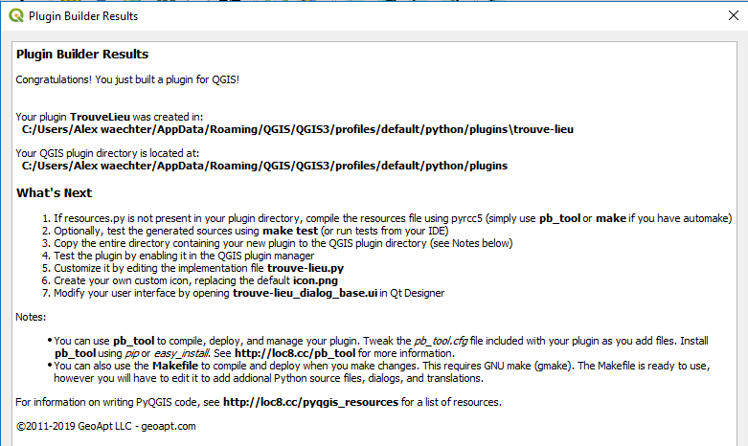
Why Bother?
Plan
Build Framework
Design Dialogues
Compile
Connect a Database
Write Python
Test and Troubleshoot
Publish

Slide 10
Why Bother?
Plan
Build Framework
Design Dialogues
Compile
Connect a Database
Write Python
Test and Troubleshoot
Publish
Qt Designer
Comes with your QGIS installation – find it on the Start menu
Open and edit the .ui (user interface) file. Drag and drop, copy and paste…fairly intuitive.
Set the objectName to be something unique and recognisable – this is what you reference in your Python code to e.g. set what happens when a button is clicked.
Tutorials available: e.g. Tech with Tim: PyQt5 Tutorial - How to Use Qt Designer

Slide 11
Why Bother?
Plan
Build Framework
Design Dialogues
Compile
Connect a Database
Write Python
Test and Troubleshoot
Publish
What is ‘compiling’? What does it do?
Takes the resources.qrc file and compiles it into a resources.py file
It also takes the .ui file and turns it into a scripted version which can be read by the plugin
The resources.py file is part of the Qt Resource System which references all binary files used in the plugin. Compiling this file generates application code that can be used in the plugin independent of which platform the plugin is being run on.
Notes:
Description of compilation is from QGIS Tutorials - build a python plugin

Slide 12
Why Bother?
Plan
Build Framework
Design Dialogues
Compile
Connect a Database
Write Python
Test and Troubleshoot
Publish
pb_tool method
Recommended method. Command line method.
https://github.com/g-sherman/plugin_build_tool
Requires you to have a terminal (command line) set up that can ‘see’ your QGIS Python installation and its libraries.
Typically this is by adding the path to your Python folder to your system PATH and/or PYTHONPATH environment variable.
Only then will you be able to install pip and install pb_tool
Notes:
Description of compilation is from QGIS Tutorials - build a python plugin

Slide 13
Why Bother?
Plan
Build Framework
Design Dialogues
Compile
Connect a Database
Write Python
Test and Troubleshoot
Publish
pb_tool method
You can test if your operating system is aware of Python by typing ‘Python’. If it’s working, then you should not get an error.
You’ll see something like the above. The >>> prompt means that you’re now in a Python terminal.
Pip install and pb_tool install need to be run in an operating system command line, not a python terminal. So close, and reopen your command line. Then try the install lines of code.
Notes:
Description of compilation is from QGIS Tutorials - build a python plugin

Slide 14
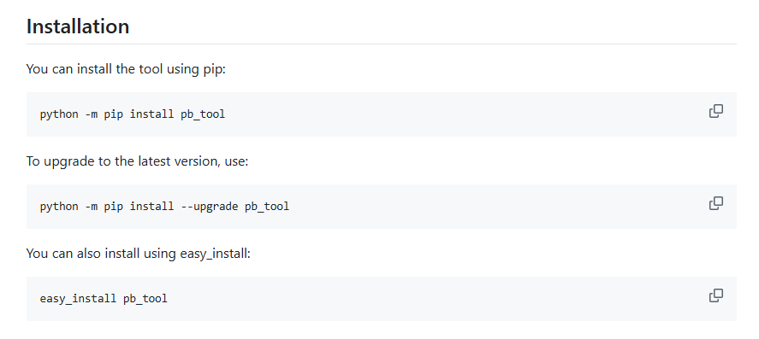
Why Bother?
Plan
Build Framework
Design Dialogues
Compile
Connect a Database
Write Python
Test and Troubleshoot
Publish
pb_tool method
Try this:
https://github.com/g-sherman/plugin_build_tool
Notes:
Description of compilation is from QGIS Tutorials - build a python plugin

Slide 15
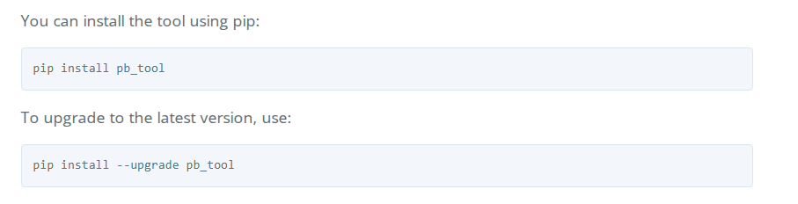
Why Bother?
Plan
Build Framework
Design Dialogues
Compile
Connect a Database
Write Python
Test and Troubleshoot
Publish
pb_tool method
Or this:
https://g-sherman.github.io/plugin_build_tool/
Notes:
Description of compilation is from QGIS Tutorials - build a python plugin

Slide 16
Why Bother?
Plan
Build Framework
Design Dialogues
Compile
Connect a Database
Write Python
Test and Troubleshoot
Publish
Expect it not to work the first time
Can be tricky to pip install the compilation tool(s):
if your system environments aren’t set up to recognize Python
You will likely need system admin privileges to add to the system PATH and PYTHONPATH variables (may need to get your IT folks involved)
Can be tricky to troubleshoot:
because your Python install may be in different places and systems set up in different ways so some online instructions may work for you and others won’t
You may have more than one version of Python installed
There’s more than one way of compiling

Slide 17
Why Bother?
Plan
Build Framework
Design Dialogues
Compile
Connect a Database
Write Python
Test and Troubleshoot
Publish
Troubleshooting resources
Check if your System Path is able to see your Python scripts:
GIS Coordinated: How to Make a QGIS Plugin in the description
Find your Python folder:
Likely somewhere like this: C:\Program Files\QGIS 3.34.10\apps\Python312, but if you’re having trouble:
Tech with Tim: PyQt5 Tutorial - How to Use Qt Designer 0:51-2:11
Another method using a batch file (Windows only): this might work even if you’re not a system admin.
QGIS Tutorials - build a python plugin good all round tutorial (non video) for building a plugin
If you’re having trouble with installing pip and you used the Standalone QGIS Installer, try uninstalling and reinstalling QGIS using the OSGeo4W advanced installer https://spatialgalaxy.net/2014/10/09/a-quick-guide-to-getting-started-with-pyqgis-on-windows/

Slide 18
Why Bother?
Plan
Build Framework
Design Dialogues
Compile
Connect a Database
Write Python
Test and Troubleshoot
Publish
Set up your Integrated Development Environment (IDE)
Text editor versus IDE:
Text editor (like Word, Notepad, or even Notepad ++) | IDE
Formatting can be difficult to read | Easier to read with colour coding
Can not be made aware of QGIS | Can be made aware of QGIS
No help with syntax errors and correction | Will tell you where you have syntax problems so you can fix them
No understanding of the parameters required by functions | Gives you prompts to help you code correctly
No access to Python libraries and pyqgis libraries of functions | Access to all the QGIS functionality, including the ability to interact with the map canvas and layers and layouts, create spatial objects, use geoprocessing tools etc etc

Slide 19
Why Bother?
Plan
Build Framework
Design Dialogues
Compile
Connect a Database
Write Python
Test and Troubleshoot
Publish
Set up your Integrated Development Environment (IDE)
Lots of IDEs out there for download:
IDLE (comes with ArcGIS – might be more difficult to set the environment to your QGIS version of Python)
PyCharm (popular choice)
Visual Studio Code (Microsoft product)
And many more! Ultimately it’s about choosing one that you can figure out how to configure, and then it’s personal preference.

Slide 20
Why Bother?
Plan
Build Framework
Design Dialogues
Compile
Connect a Database
Write Python
Test and Troubleshoot
Publish
Set up your Integrated Development Environment (IDE)
The essential thing you have to do is make your IDE ‘aware’ of QGIS and its version of Python. The PATH and PYTHONPATH system environment variables might come into play here too - see previous slides.
Set the ‘environment’
Point your IDE at the version of Python that came with your QGIS installation
When it works, you’ll be able to add a statement like
from qgis.core import *
And you won’t get the red squiggle under qgis.core

Slide 21
Why Bother?
Plan
Build Framework
Design Dialogues
Compile
Connect a Database
Write Python
Test and Troubleshoot
Publish
Set up your Integrated Development Environment (IDE)
This worked for me, to set up a development environment in Visual Studio Code
https://www.youtube.com/watch?v=9i16cFZy5M4
https://www.youtube.com/watch?v=NdsTU3NMMiM

Slide 22
Why Bother?
Plan
Build Framework
Design Dialogues
Compile
Connect a Database
Write Python
Test and Troubleshoot
Publish
Resources for learning Python
How to think like a computer – coding games (fun for kids and adults!)
Brilliant, Coddy, etc
General syntax courses such as:
https://www.w3schools.com/python/
QGIS-specific tutorials such as:
https://courses.spatialthoughts.com/pyqgis-masterclass.html
Existing Plugins!

Slide 23
Why Bother?
Plan
Build Framework
Design Dialogues
Compile
Connect a Database
Write Python
Test and Troubleshoot
Publish
A few tips
Break down what you want to do into small steps - don’t try to do too much with each line of code
Use variables
Use Ctrl + F to search back up existing code to figure out what a variable is referencing
GIS Stack Exchange and a google search are your friends
When searching for help online, include ‘pyqgis’ in your search term and pay attention to QGIS and Python version (3 or 4)
Trial and error is part of the process, even for experts
Don’t forget to reload your plugin every time you want to test a code edit in QGIS! Either close and reopen QGIS or use Plugin Reloader (that we installed earlier).

Slide 24
Why Bother?
Plan
Build Framework
Design Dialogues
Compile
Connect a Database
Write Python
Test and Troubleshoot
Publish
A few tips
Test sections of code in isolation where possible
Use the syntax help in your IDE. Red squiggles indicate something is wrong. QGIS will not load a plugin that has syntax errors, so you have to fix these before you’ll be able to test run from QGIS.
Add print statements to show you what a given variable is being set to at a given point in the program. In QGIS, open the Python console
Forcing a crash by putting in a dud line of text ‘numpty’ can be useful to show you the status of a map at a given point in the program.
Use error traps and message boxes with troubleshooting info like line number and variable values at time of crash.

Slide 25
Why Bother?
Plan
Build Framework
Design Dialogues
Compile
Connect a Database
Write Python
Test and Troubleshoot
Publish
Why use a database to store data instead of layers in my GIS?
Speed when handling big data
When connection made through a plugin, it will always work regardless of whether or not the user has certain layers loaded into their map
Can be easier to maintain (feed data updates to your users)

Slide 26
Why Bother?
Plan
Build Framework
Design Dialogues
Compile
Connect a Database
Write Python
Test and Troubleshoot
Publish
Set up a SQL Database that will be accessible from QGIS
SQL Server Management Studio
Create new database
Create user and their password (Under Logins). Match them to the server role public and map them to your new placenames database
Set permissions on the new database (in the Properties) to grant this user permission to Connect and Select

Slide 27
Why Bother?
Plan
Build Framework
Design Dialogues
Compile
Connect a Database
Write Python
Test and Troubleshoot
Publish
Connecting to a SQL Database from within a plugin
Import pyodbc or equivalent database connector.
Set your connection string to a variable
You need the location of the database (the server name), the name of the database, and user credentials in your connection string.
This .format structure makes the connection string more secure against a form of hacking called SQL injection.

Slide 28
Why Bother?
Plan
Build Framework
Design Dialogues
Compile
Connect a Database
Write Python
Test and Troubleshoot
Publish
Embed a SQL query in the plugin code
Has to be a text string
Can use concatenation to built in variables that have been set by the earlier Python
Very difficult to test when it’s embedded, so test your expression thoroughly in SQL Server Management Studio first
For queries that you run frequently, you might want to look into creating a custom SQL function that you can call, which simplifies the query

Slide 29
Why Bother?
Plan
Build Framework
Design Dialogues
Compile
Connect a Database
Write Python
Test and Troubleshoot
Publish
Good | Better | Best
It works for me! | It works for me and others in my organisation! | It works gracefully for me and others in my organisation, even when we’re being numpties and even if I need to implement edits.
Hallelujah! Pub! | I am now a professional programmer delivering a product to help my colleagues work more efficiently. You coming to the pub? | I am now a professional programmer that can deliver efficiencies for others while also spending less time myself supporting them. Pudding too?

Slide 30
Why Bother?
Plan
Build Framework
Design Dialogues
Compile
Connect a Database
Write Python
Test and Troubleshoot
Publish
Ask your users to add the plugin to their plugins folder |  | Publish to the official QGIS Plugins Repository
Dependent on everyone in your organisation to remember to do this admin task Dependent on everyone to do this again for every update No ‘official’ version – can end up with version drift if multiple people go in and edit their own version of the code |  | Available to everyone Easier to publish updates and maintain version control Needs more thorough testing, supporting files and metadata Won’t work for other people anyway if the plugin has dependencies on your other systems

Slide 31
Why Bother?
Plan
Build Framework
Design Dialogues
Compile
Connect a Database
Write Python
Test and Troubleshoot
Publish
Ask your users to add the plugin to their plugins folder | Set up and add to your own custom QGIS Repository | Publish to the official QGIS Plugins Repository
Dependent on everyone in your organisation to remember to do this admin task Dependent on everyone to do this again for every update No ‘official’ version – can end up with version drift if people go in and edit their own version of the code | Easier to publish updates and maintain version control Easier to ensure that everyone in your organisation is using the most recent version You do still need to add the repository to the settings of every new user when they start out. | Available to everyone Easier to publish updates and maintain version control Needs more thorough testing, supporting files and metadata Won’t work for other people anyway if the plugin has dependencies on your other systems

Slide 32
Why Bother?
Plan
Build Framework
Design Dialogues
Compile
Connect a Database
Write Python
Test and Troubleshoot
Publish
Add the repository location path to each user’s Plugins Settings
Plugins Manager > Settings > Plugin Repositories > Add
Repository folder must contain
1. Zipped folder for each plugin, containing the metadata.txt file created by Plugin Builder. Number each new version!
2. Plugins.xml, with a section for each plugin in the repository. Ensure the latest version number is listed for each plugin.
(can edit an XML in something like Notepad ++ or your IDE)
Consider using the ‘Check for updates on start-up’ option in the Plugins Settings

Slide 33
Steps to make the Placefinder plugin your own
Create the placenames database
  Via SQL Server Management Studio:
  Create a new Database
    General tab: name, owner
    Options tab: accept all defaults
Download the OS Open Names csvs and figure out which ones you wish to add to your plugin (there’s one csv for every 10km grid square)
https://osdatahub.os.uk/data/downloads/open/OpenNames
If your only database tool is MS Access or you have nothing at all, it is actually really quite easy to get started with SQL Server Express. It is free, and using it for Placefinder might be the perfect entry into this powerful database tool.
https://www.youtube.com/watch?v=Wr1AViAda3k – How to get started with SQL Server Express, including installing Management Studio.

Slide 34
Steps to make the Placefinder plugin your own
Run a SQL query script which does a few things:
  Creates the user login credentials and permissions
  Creates the table schema that will be populated with the OS Open Names content
  Populates the placenames database with the contents of the OS Open Names csvs by bulk insert
    Don’t forget the make the edits to the script as prompted.
    You’ll have to bulk insert each csv individually but it’s a fairly quick process nonetheless

Slide 35
Steps to make the Placefinder plugin your own
Create a csv with the same table structure containing your local names.
  Required attributes (the others can be left blank):
    A unique key [col A],
    Place name [col C],
    minimum bounding rectangle Xmin, Ymin, Xmax, Ymax coordinates [col M-P]
    (and/or) centroid coordinates X,Y [col I-J],
      In OS Open Names, postcodes have only centroid coordinates, not full bounding box geometry. The plugin therefore uses the bounding box geometry if it exists, and if not, then it uses the centroid coordinates. If you have some very small features that you wish to add to your placenames database, you may wish to represent them with the central coordinates instead of a bounding box. Up to you.
    the type of location (e.g. ‘Local Wildlife Site’, ‘SSSI’, ‘Ancient Woodland’, ‘River Catchment’ etc.) [col H]
Bulk insert this csv in the same way as the OS Open Names csvs.

Slide 36
Steps to make the Placefinder plugin your own
Install the placefinder plugin from the zip file provided (Plugins Manager > Install from Zip)
Open the Python code for the placefinder plugin in your IDE (placefinder.py) and make a few minimal edits
  [line 170]: set the servername variable to your own server name
  [line 172]: set the password to match the stronger password that you replaced ‘Pa$$word123’ with.
    These edits are simple enough that you could do them in a simpler code editor like Notepad++ instead of having to set up a fully fledged IDE that recognises QGIS Python.
    If you do use Notepad++, before opening the plugin code, go into the settings and under Preferences > Language, make sure the ‘Replace by space’ box is unticked. (Python is very picky about indentation and will throw errors if an indent is replaced by four spaces).
Test!

Slide 38
Why Bother?
Plan
Build Framework
Design Dialogues
Compile
Connect a Database
Write Python
Test and Troubleshoot
Publish

